Slide 1

Tutorial sesion:
Mueller Matrix Ellipsometry
Oriol Arteaga
Dep. Applied Physics and Optics
University of Barcelona

Slide 2
Outline
Historical introduction
Basic concepts about Mueller matrices
Mueller matrix ellipsometry instrumentation
Further insights. Measurements and simulations
Symmetries and asymmetries of the Mueller matrix. Relation to anisotropy.
Applications and examples
Concluding remarks

Slide 3
Historical introduction

Slide 4
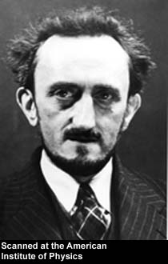
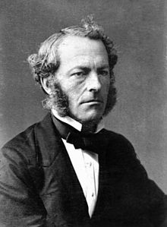
Historical introduction
G G. Stokes
in 1852
Francis Perrin
in 1942
Stokes Parameters
90 years, almost forgotten!
F. Perrin, J. Chem. Phys. 10, 415 (1942). Translation from the french:
F. Perrin, J. Phys. Rad. 3, 41 (1942)

Slide 5
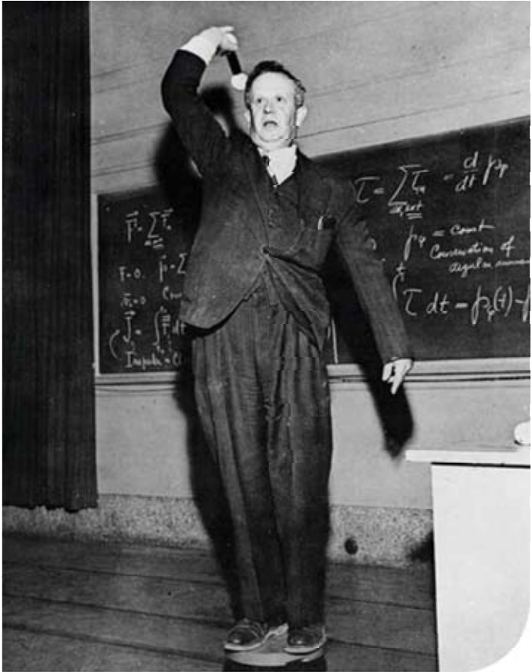

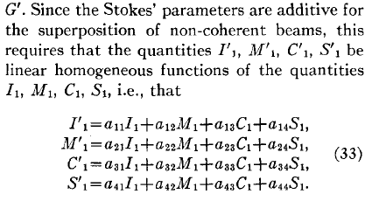

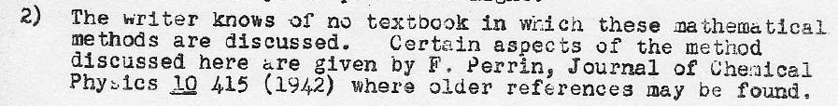
Historical introduction
1943
Hans Mueller (1900-1965)
1929
Paul Soleillet (1902-1992)
1942
Francis Perrin (1901-1992)
1852
G G. Stokes (1819-1903)
Stokes Parameters
P. Soleillet, Ann. Phys. 12, 23 (1929)
F. Perrin, J. Phys. Rad. 3, 41 (1942)
K. Järrendahl and B. Kahr, Woollam newsletter, February 2011, pp. 8–9
H. Mueller, Report no. 2 of OSR project OEMsr-576 (1943)

Slide 6
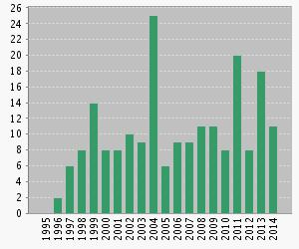
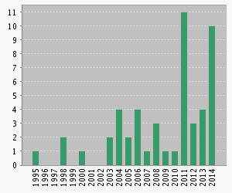
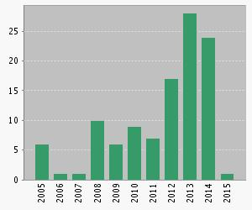
Historical introduction
P. S. Hauge, Opt. Commun. 17, 74 (1976).
R. M. A. Azzam, Opt. Lett. 2, 148-150 (1978).
Instrumental papers about the dual rotating compensator technique
“Generalized ellipsometry”
“Mueller matrix ellipsometry”
“Mueller matrix spectroscopic ellipsometry”
Web of Science Citation Reports

Slide 7
Basic concepts about Mueller matrices

Slide 8
Basic concepts about Mueller matrices
I Intensity
p Degree of polarization
χ Azimuth
φ Ellipticity
No depolarization:
Phenomenological description of any scattering experiment

Slide 9
Basic concepts about Mueller matrices. No depolarization
A nondepolarizing Mueller matrix is called a Mueller-Jones matrix
Equivalence
A Jones or Mueller-Jones Jones depends on 6-7 parameters.
M is 4x4 real
is 2x2 complex matrix
But note that the 16 elements of a Mueller-Jones matrix can be still all different!
Transformation

Slide 10
Basic concepts about Mueller matrices. No depolarization and isotropy
All modern ellipsometers measure elements of the Mueller matrix.
This is a common representation for isotropic media:
p
s
p
s
Standard ellipsometry:
Thickness measurements of thin films
Optical functions of isotropic materials
This Mueller matrix depends only on 2 parameters

Slide 11
Basic concepts about Mueller matrices. Depolarization
Depolarization is the reduction of the degree of polarization of light. Typically occurs when the emerging light is composed of several incoherent contributions.
Reasons:
Sample exhibits spatial, temporal or frequency heterogeneity over the illuminated area
Quantification of the depolarization: Depolarization index (DI)
The DI of a Mueller-Jones matrix is 1
J. J. Gil, E. Bernabeu, Opt. Acta 32 (1985) 259

Slide 12
Mueller matrix ellipsometry instrumentation

Slide 13

Mueller matrix ellipsometry instrumentation
PSG
PSA
Polarization state generator: PSG
Polarization state analyzer: PSA
P
P
One exception: division-of-amplitude ellipsometers
C
C
In a MM ellipsometer the PSG and PSA typically contain:
A polarizer (P)
A compensating or retarding element (C)

Slide 14
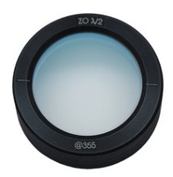
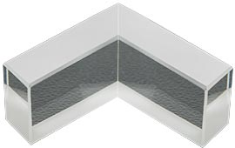
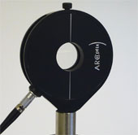
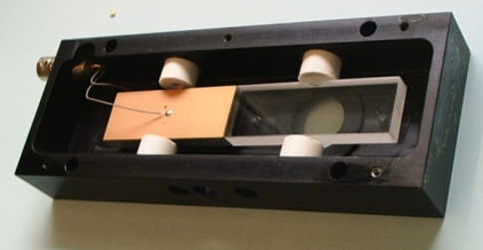
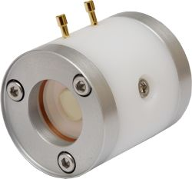
Mueller matrix ellipsometry instrumentation
The compensating element is the main difference between different types of Mueller matrix ellipsometers
Rotating Retarders
Fixed Retardation
Changing azimuth
Waveplates are not very acromatic
Fresnel rohms are hard to rotate
Mechanical rotation
P. S. Hauge, J. Opt. Soc. Am. 68, 1519-1528 (1978)
Liquid cristal cells
Variable Retardation (nematic LC)
Changing azimuth (ferroelectric LC)
Not transparent in the UV
Temperature dependence
No frequency domain analysis
E. Garcia-Caurel et al. Thin Solid Films 455 120-123 (2004).
Piezo-optic modulators
(photoelastic modulators)
Variable Retardation
Fixed azimuth
Two PEMs for each PSG or PSA
Too fast for imaging
O. Arteaga et al. Appl. Optics 51.28 6805-6817 (2012).
Electro-optic modulators
(Pockels cells)
Variable Retardation
Fixed azimuth
Two cells for each PSG or PSA
Small acceptance angle
Too fast for imaging
R. C. Thompson et al. Appl. Opt. 19, 1323–1332 (1980).

Slide 15
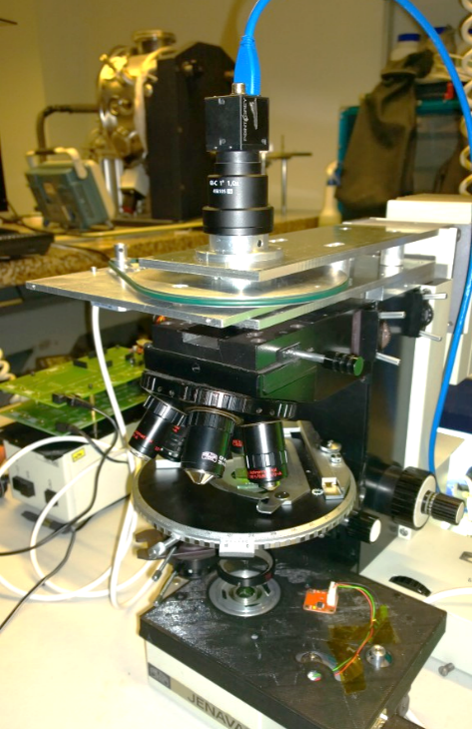
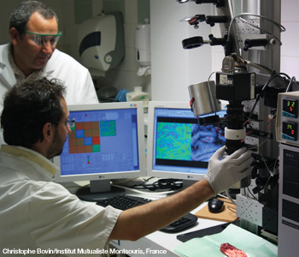
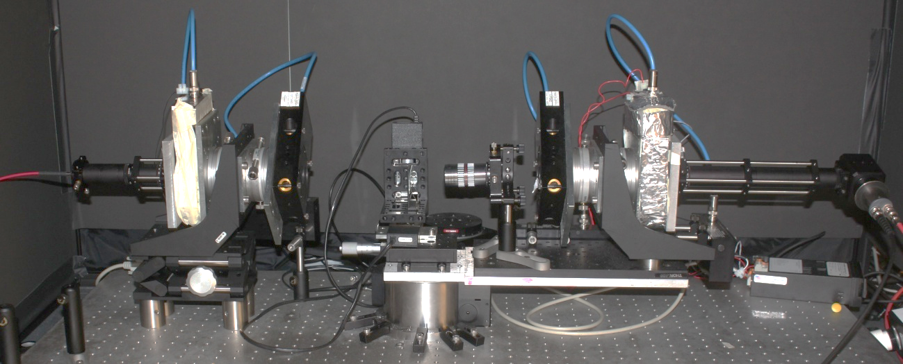
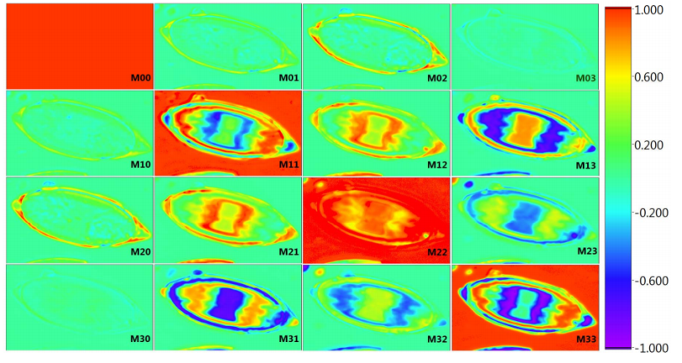
Mueller matrix ellipsometry instrumentation
The PSA and PSG of Mueller matrix ellipsometers are no different from other Mueller matrix polarimetric approaches
spectroscopic polarimeter based on four photoelastic modulators
Normal-incidence reflection imaging based on liquid crystals
Mueller matrix microscope with two rotating compensators
Instrumentally wise no different from a MM ellipsometer. Lots of imaging applications in chemistry, medicine, biology, geology, etc.
O. Arteaga et al, Appl. Opt. 53, 2236-2245 (2014)
80 um

Slide 16
Further insights
Measurement and simulations

Slide 17
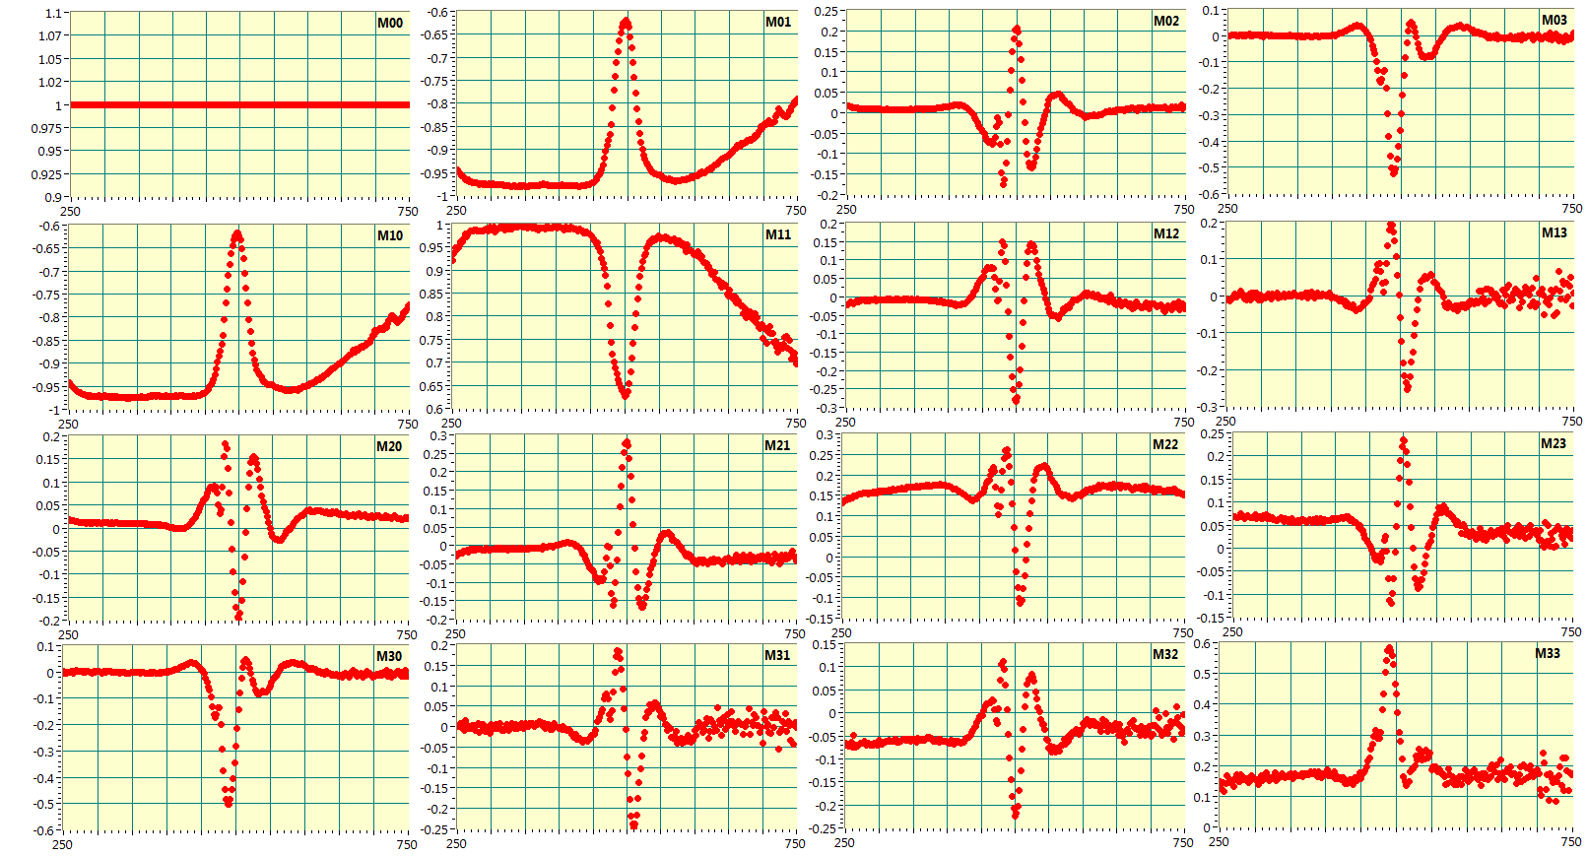
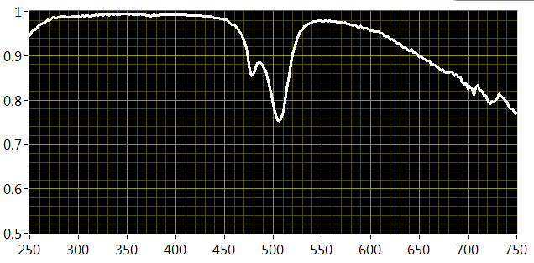
Further insights. Measurement and simulations
A spectroscopic Mueller matrix ellipsometer produces this type of data:
Is this MM depolarizing?
If the depolarization is not significative we can find a proper non-depolarizing estimate

Slide 18
Further insights. Measurement and simulations
Simulation usually generates a
Jones/Mueller-Jones matrix
(coherent model)
Measurement:
Mueller matrix
Objective: Finding a good nondepolarizing estimate (a Mueller-Jones matrix) for a experimental Mueller matrix
One option,
Cloude estimate using the Cloude sum decomposition
S. R. Cloude, Optik 75, 26 (1986).
R. Ossikovski, Opt. Lett. 37, 578-580 (2012).

Slide 19
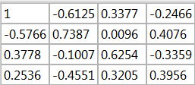
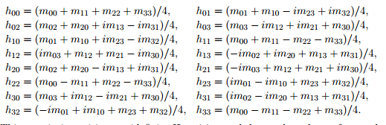
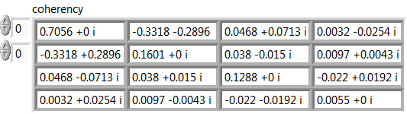
Further insights. Measurement and simulations. Example
Experimental Mueller matrix
1. Calculate the Coherency matrix
Coherency matrix, H
2. Calculate the eigenvectors of H (is a hermitian matrix, so eigenvectors are real)

Slide 20

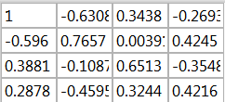
Further insights. Measurement and simulations. Example
3. The eigenvector corresponding to $λ_{0}$ defines the Jones matrix corresponding to
Jones matrix
Initial Experimental Mueller matrix
Best nondepolarizing estimate
Suitable to compare with coherent models

Slide 21
Further insights. Measurement and simulations. Expressing non-depolarizing data
1
2
3
This notation is very suitable for normal-incidence transmission and reflection data:
CD: circular dichroism/diatt.
CB: circular birefrigence/retard.
LD: horiz. linear dichroism/diatt.
... etc
O. Arteaga & A. Canillas, Opt. Lett. 35, 559-561 (2010)
For the previous example:
1
2
3

Slide 22
Mueller matrix symmetries and anisotropy

Slide 23
Mueller matrix symmetries and anisotropy
In the isotropic case
The MM elements with an asteriks vanish in absence of absorption and J is real (asumming semi-infinite substrate as a sample)
1
But this symmetry also applies to some situations with anisotropy!
Uniaxial
Biaxial (orthorombic)
Arrows are O. A.
Biaxial (monoclinic)
Arrow is P. A.

Slide 24
Mueller matrix symmetries and anisotropy
The MM elements with an asteriks vanish in absence of absorption and J is real (asumming semi-infinite substrate as a sample)
2
Biaxial (orthorombic)
Uniaxial
Biaxial (monoclinic)
Arrows are O. A.
Arrow is P. A.

Slide 25
Mueller matrix symmetries and anisotropy
The MM elements with an asteriks vanish in absence of absorption and J is real (asumming semi-infinite substrate as a sample)
3
Uniaxial
Biaxial (orthorombic)
Biaxial (monoclinic)
Arrow is O. A.
Arrows are O. A.
Arrow is P. A.

Slide 26
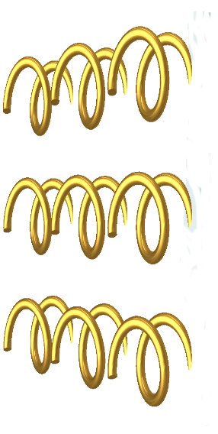
Mueller matrix symmetries and anisotropy
The MM elements with an asteriks vanish in absence of absorption and J is imaginary (asumming semi-infinite substrate as a sample)
4
Bi-isotropic media

Slide 27
Applications and examples

Slide 28
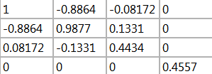
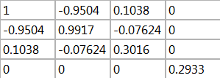
Applications and examples. A general idea about anisotropy
Instrinsic anisotropy vs structural/form anisotropy
Expect small values of these elements for intrinsic anisotropy
E.g. Reflection on a calcite substrate
AOI 65º

Slide 29
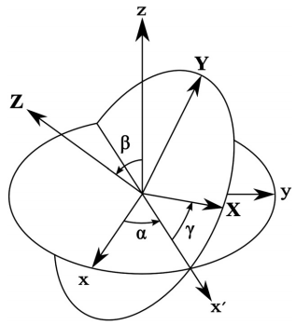
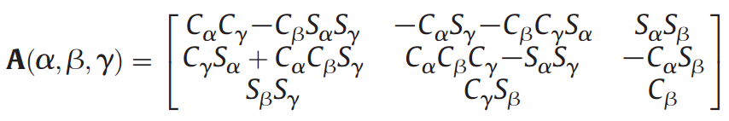


Applications. Dielectric tensor of crystals
Measure the complex dielectric function (DF) tensor above and below the band edge
$$D_{i}=ε_{ij}{(λ)E}_{j}$$
The dielectric tensor is symmetric
A magnetic field breaks the symmetry. E.g. MOKE
$$ε^{′}=AεA^{T}$$
The principal values of the tensor correspond to crystal symmetry directions for isotropic, uniaxial and orthorhombic materials
Berreman’s 4x4 complex formalism is used to calculate ρ, ρ_{sp} and ρ_{ps} from elements of $ε$ and the angle of incidence (a fully analytical treatment is sometimes possible).

Slide 30

Applications. Dielectric tensor of crystals
General scheme of the approach:
EXPERIMENT
THEORY
$$ε$$
MUELLER MATRIX
CONSTITUTIVE TENSORS
e.g. Cloude’s
JONES MATRIX
MAXWELL EQUATIONS (Berreman formulation)
MATRIX
MULTIPLICATION of complex 4x4 matrices
(forward and backward propagating waves)

Slide 31
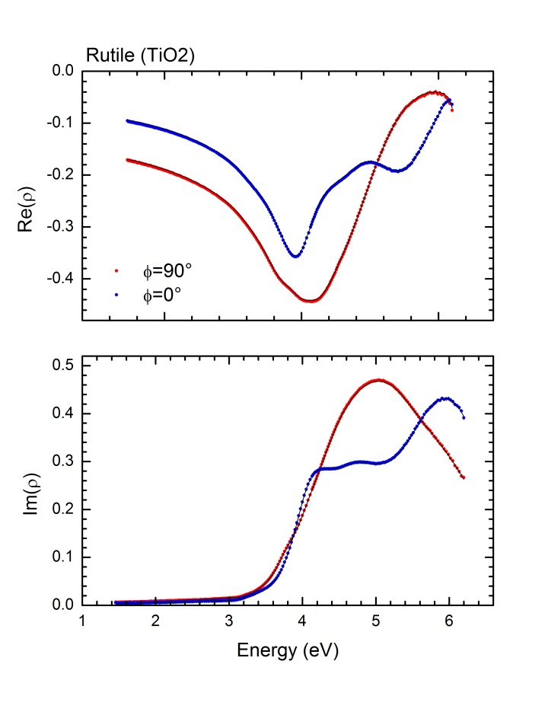
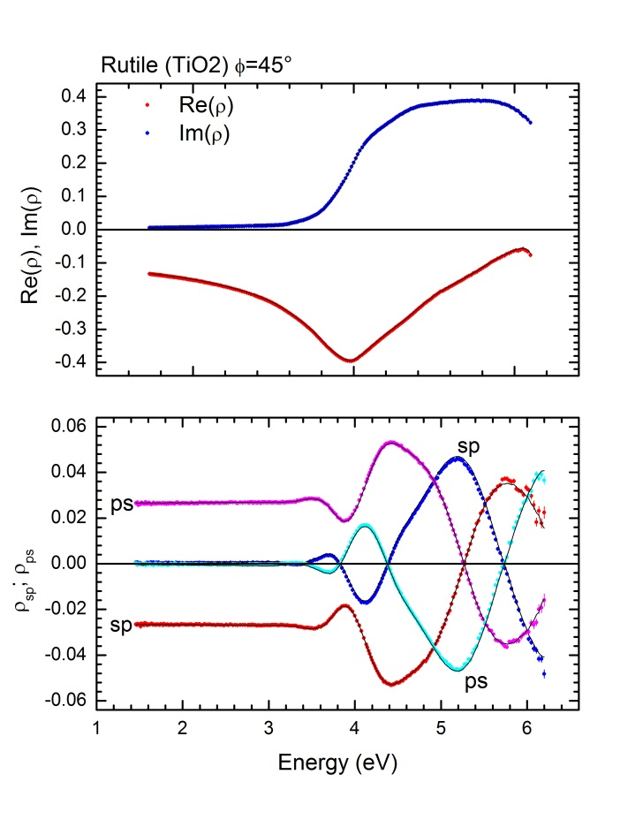
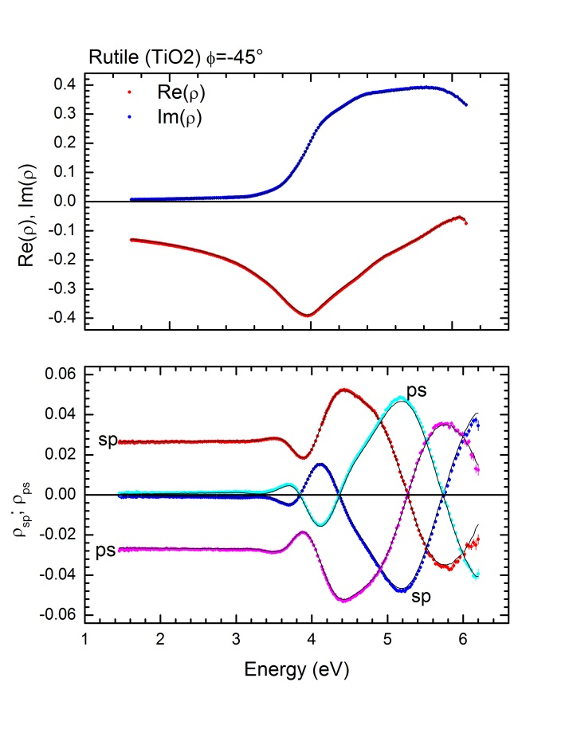
Applications. Dielectric tensor of crystals
Rutile (Uniaxial)
G. E. Jellison, F. A. Modine, and L. A. Boatner, Opt. Lett. 22, 1808 (1997).
Jellison and Baba, J. Opt. Soc. Am. 23, 468 (2006).

Slide 32
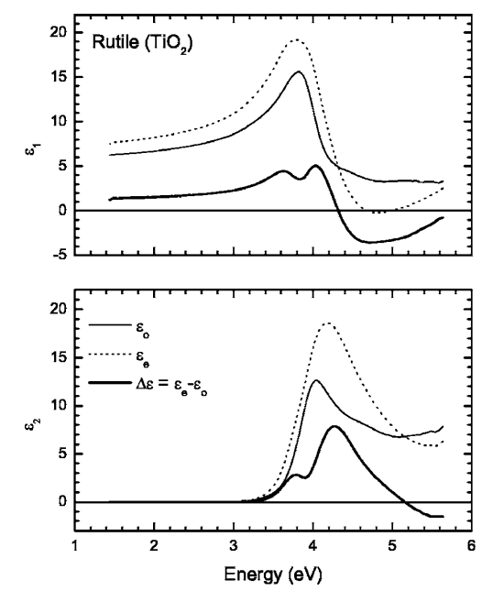
Applications. Dielectric tensor of crystals
Rutile (Uniaxial)

Slide 33
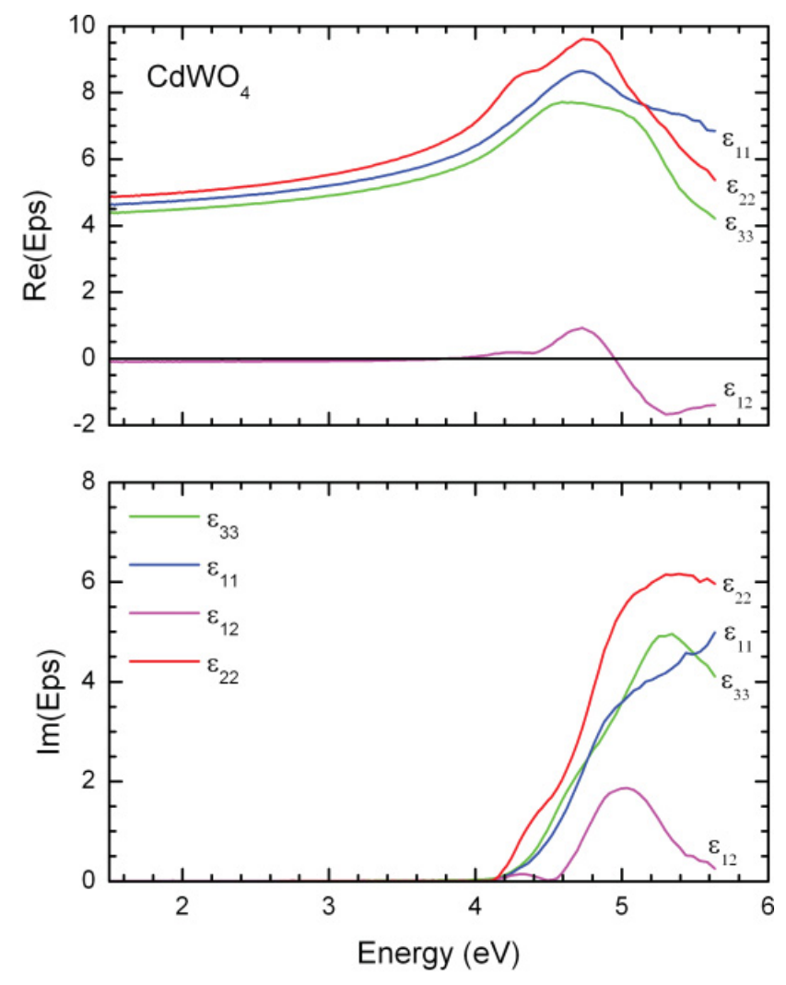
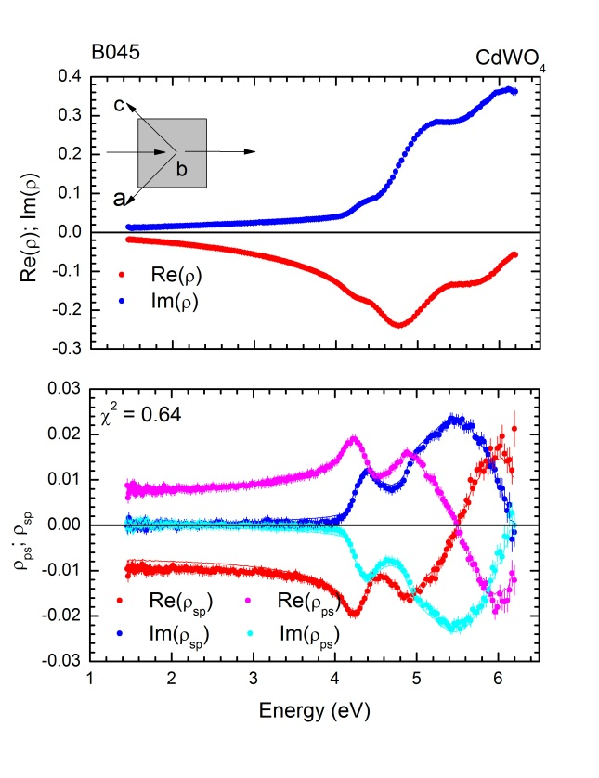
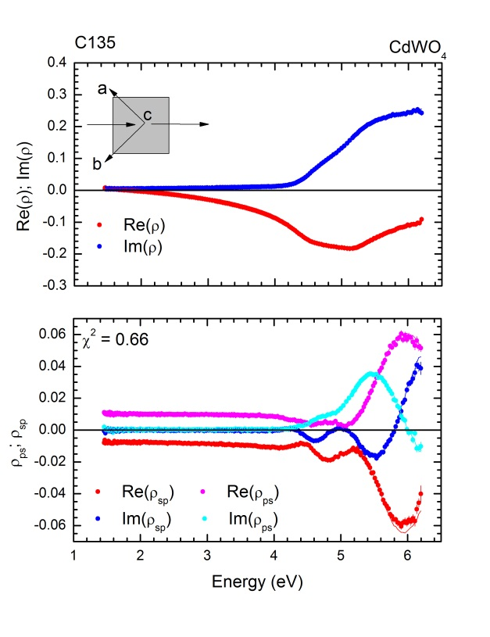
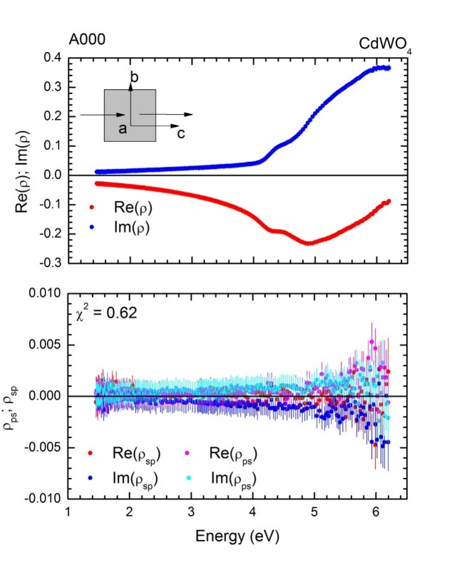
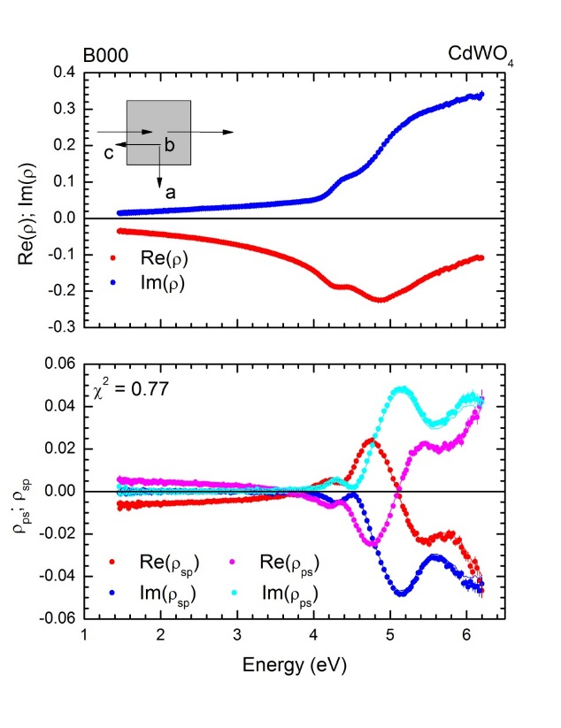
Monoclinic CdWO₄
Applications. Dielectric tensor of crystals
Note that a non-diagonal dielectric tensor can led to a block diagonal MM
Jellison, McGuire, Boatner, Budai, Specht, and Singh, Phys. Rev. B 84, 195439 (2011).

Slide 34
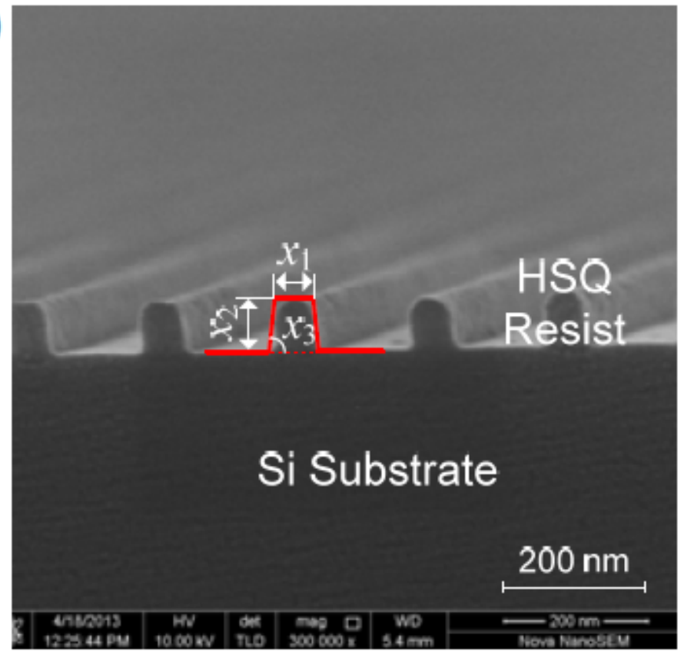
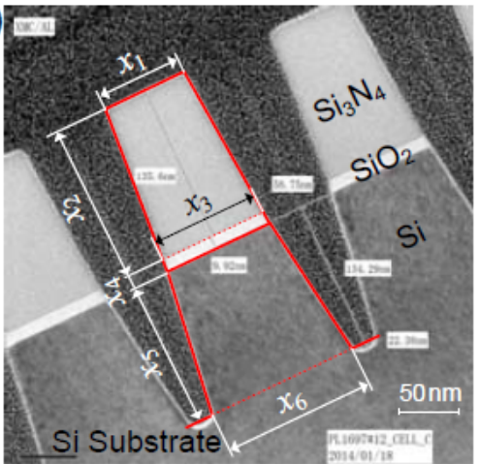
Mueller matrix Scatterometry
(Form anisotropy)
Measurements in periodic grating-like structures
Analysis of the Zeroth-order diffracted light (specular reflection).
Qualitative understanding of the measurements is posible attending to MM symmetries, and Rayleigh anomalies of higher orders. Energy distribution to higher orders
e-beam patterned grating structure
Expect the same symmetries as for a sample with optic axis lying in the plane of the sample
Rigorous-coupled wave analysis (RCWA). Field components expanded into Fourier series
Trench nanostructure encountered in the manufacturing of flash memory storage cells

Slide 35
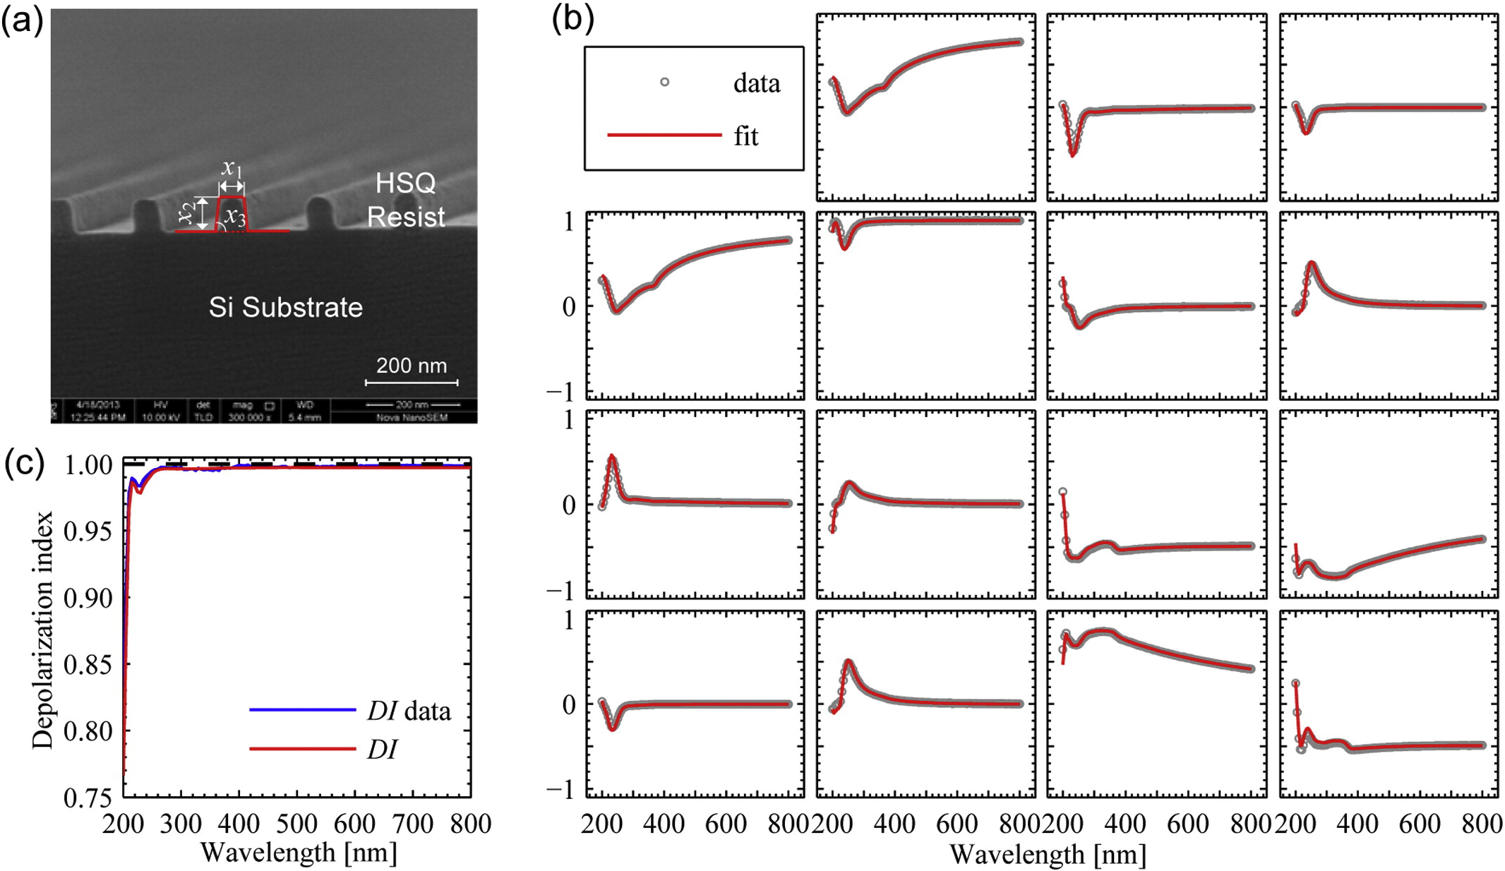
Mueller matrix Scatterometry
S. Liu, et al., Development of a broadband Mueller matrix ellipsometer as a powerful tool for nanostructure metrology, Thin Solid Films , in press

Slide 36
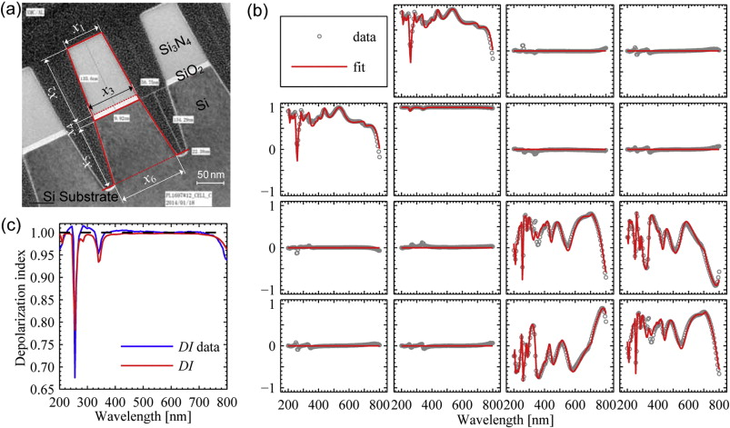
Mueller matrix Scatterometry
S. Liu, et al., Development of a broadband Mueller matrix ellipsometer as a powerful tool for nanostructure metrology, Thin Solid Films , in press

Slide 37
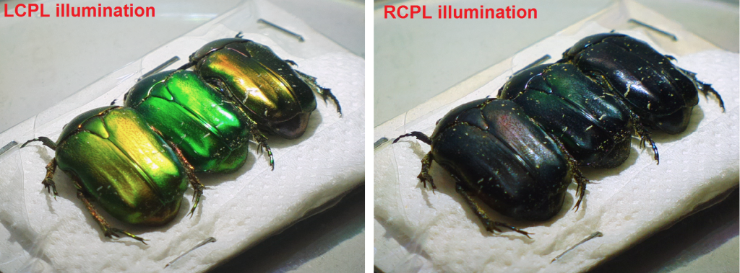
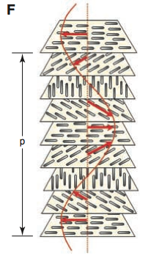
Helicoidal Bragg reflectors
Cholesteric liquid crystal
Classical approximate formulas for Bragg reflection from cholesteric liquid crystals
Structural chirality, no real magneto-electric origin.

Slide 38
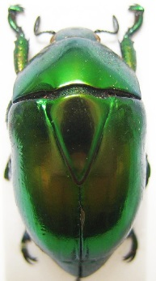
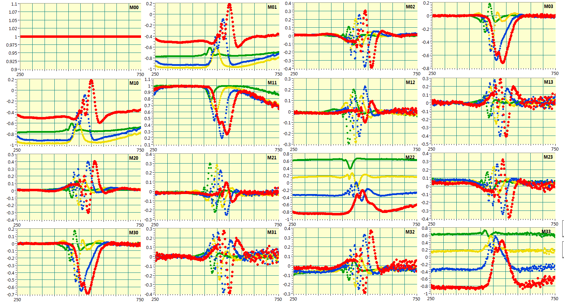
Helicoidal Bragg reflectors
AOI 35
AOI 50
AOI 60
AOI 70
Macraspis lucida

Slide 39
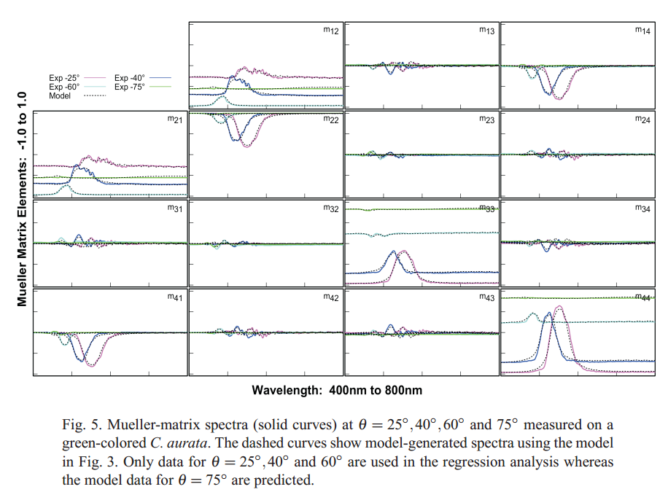
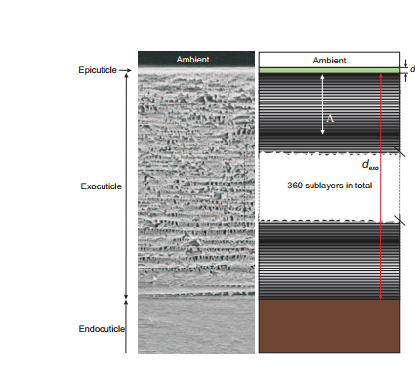
Helicoidal Bragg reflectors
H. Arwin et al. Opt. Express 21, 22645-22656 (2013).
H. Arwin, et al. Opt. Express 23, 1951-1966 (2015).

Slide 40
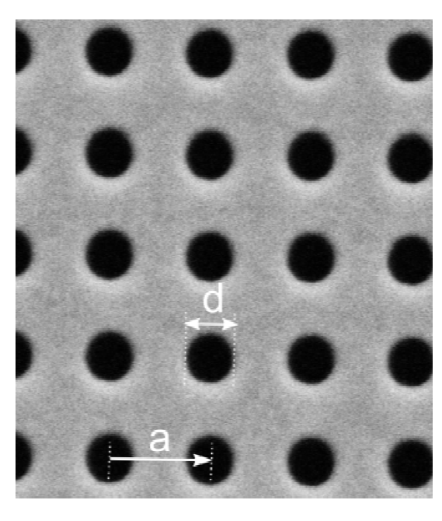
Plasmonic nanostructures
Typically measurements are made on 2D periodic nanostructures with characteristic dimensions comparable or smaller than the wavelength of light
Big spatial dispersion effects
~
The electric polarization at a certain position is determined not only by the electric field at that position, but also by the fields at its neighbors
d= 250 nm
a= 530 nm
…. And the neighbors change depending on how we orient the sample in the ellipsometer….

Slide 41


Plasmonic nanostructures
Projections of a square lattice
TILT
In transmission a square lattice is isotropic
This what the photons of the ellipsometer will “see”
RECTANGULAR
RHOMBIC
OBLIQUE

Slide 42
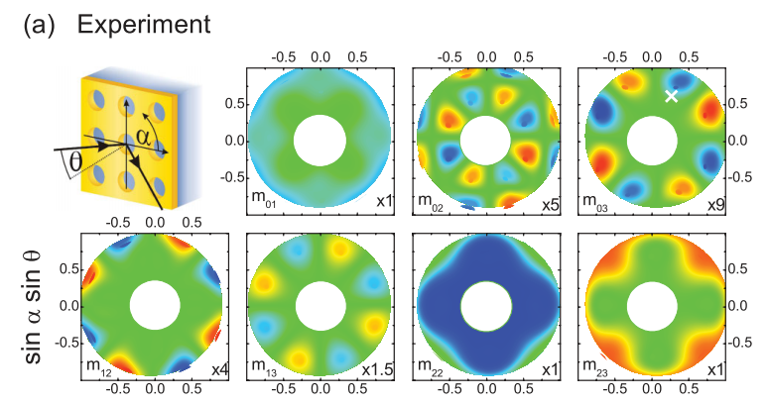
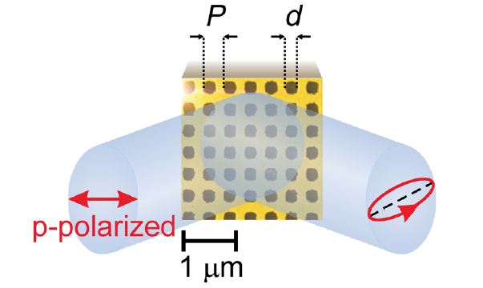
Plasmonic nanostructures
B. Gompf et al. Phys. Rev. Lett. 106, 185501 (2011)

Slide 43



Plasmonic nanostructures
Even a highly symmetric plasmonic nanostructure must be described by a non-diagonal, asymmetric Jones matrix whenever the plane of incidence does not coincide with a mirror line
O. Arteaga, et al., Opt. Express., 22, 13719, (2014)

Slide 44
I have a isotropic sample, should I study with Mueller matrix ellipsometry?
Concluding remarks
Yes, it never hurts. Having access to the whole MM also helps to verify the alignment of the sample.
I have an anisotropic sample, can I study it with standard ellipsometry?
Most likely yes, although Mueller matrix ellipsometry is arguably better suited.
Reorientations are going to be necessary. Will fail if there is some significant depolarization
I have an optically active sample, can I study it with standard ellipsometry? And with Mueller ellipsometry?
Not with standard ellipsometry. Possibly with Mueller ellipsometry. But be aware! In reflection you will be NOT measuring directly optical rotatory dispersion or circular dichroism.

Slide 45
Summary of ideas to take home
When posible (small depo) convert a experimental MM in a Mueller-Jones matrix or a Jones matrix and work from that
Symmetries or assymetries of a MM give information about the orientation the sample and/or the crystallographic system
For intrinsic anisotropy the non-diagonal Jones elements are small and the Mueller matrix is close to a NSC matrix. If they are large suspect about structure-induced anisotropy or misalignement of the sample
Mueller matrix ellipsometry has the same applications as standard ellipsometry, plus it handles accurately anisotropy and depolarization. Important for crystals, nanotechnology, scatterometry, etc

Slide 46
Some further references
MM symmetries
MM scatterometry
O. Arteaga, Thin Solid Films 571, 584-588 (2014)
H. C. van de Hulst, Light scattering by small particles, New York, Dover (1981)
A. De Martino et al., Proc. SPIE 6922, 69221P (2008).
S. Liu, et al., Development of a broadband Mueller matrix ellipsometer as a powerful tool for nanostructure metrology, Thin Solid Films , in press
DF of low symmetry crystals
G. E. Jellison et al., Phys Rev. B 84, 195439(2011)
MI Alonso et al., Thin Solid Films 571, 420-425 (2014)
G. E. Jellison et al. J. Appl. Phys. 112, 063524 (2012)
MM and metamaterials
T. Oates et al., Opt. Mat. Expr. 2646, 2014.
MMs at normal incidence transmission
R. Ossikovski, Opt. Let. 39,2330-2332 (2011).
O. Arteaga et al, Opt. Let. 35, 559-561 (2010)
J. Schellman, Chem. Rev., 87, 1359-1399 (1987)
MMs at normal-incidence reflection
O. Arteaga et al. Opt. Let. 39, 6050-6053 (2014)

Slide 47



Acknowledgments
R. Ossikovski (EP), A. Canillas (UB),
S. Nichols (NYU) , G. E. Jellison (ORNL)
oarteaga@ub.edu
http://www.mmpolarimetry.com

